Slide 1
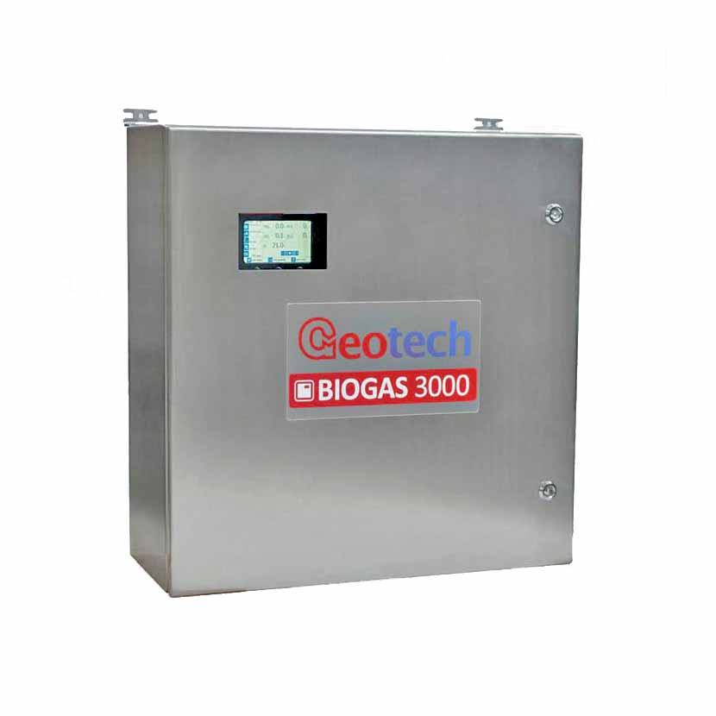
BIOGAS 3000
FAQ’s

Slide 2
BIOGAS 3000 FAQ’s
Question | Answer
How do the alarm relays work on the BIOGAS 3000? | The relays are operated in a ‘fail safe’ mode, i.e. normally energised. This means wiring across connections 11 (common) and 12 (normally closed) during an alarm condition will complete the circuit as the relay will be de-energised.
Are the analogue outputs ‘sink’ or ‘source’? | By default, they are configured for ‘Sink’, however, a simple link change will change this for ‘source’ outputs. Please see section 4.11 in the operating manual for further details.
What is the ‘first time run set-up’ on the BIOGAS 3000? | When switching the instrument on for the first time since manufacture or service the instrument will detect the condition and run a set-up mode. This allows the system to be fully configurable by the end user without Geotech support or configuration.

Slide 3
BIOGAS 3000 FAQ’s
Question | Answer
Can the system be used as a totalizer for any of the gas channels, for instance CH4? | Yes, if the system is connected to another PLC, one of the BIOGAS 3000 relays can be configured to change state when a new reading is available (either by Analogue or ModBus). The host PLC will need some simple logic to react to this new reading and total the sum of historical values plus the most recent value.
My instrument keeps displaying a ‘low flow’ warning, why? | This is an indication of low flow to the analyser or blockage in the sample line. Check for any blockages (such as water ingress), replace filters where necessary and check the flow indication is at a satisfactory level (approx. 200-300ml/min). If problems still persist please contact our technical support team for further assistance.
The readings from my BIOGAS 3000 are not the values that I am expecting | What values are expected? Check the system drain valve is closed? Ensure there is no blockage? When was the last user calibration performed? Is there calibration gas on site? Is there access to a comparison analyser? This information will assist our technical support team towards quick diagnosis and resolution to the query.

