Slide 1
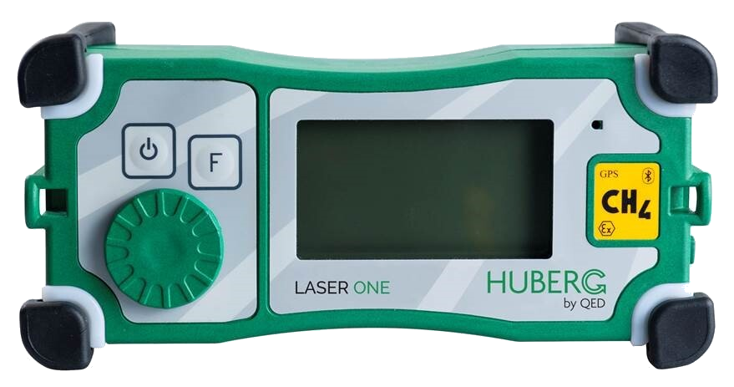
Laser One FAQ’s

Slide 2
Laser One FAQ’s
Question | Answer
What technology is used in the Laser One | The Huberg Laser One employs tunable diode laser absorption spectroscopy, which is basically laser technology with an applied electronic signal. The combined signal is tuned to the specific spectrum of absorption for methane and amplified for greater sensitivity.
Can the Laser One read multiple gasses? | No, the Laser One is specifically tuned to detect and identify CH₄ (methane) gasses. The benefit of the technology engineered within this instrument ensures that it will never give a false reading due to the effects of cross-gassing.
What is the measurement range for the Laser One? | The Laser One provides a wide range of measurements. It measures from 0.5ppm to 100% of volume, (or 1,000,000ppm). The readout will switch automatically from parts per million to percentage of volume above 10,000ppm. This switch is immediate. Some other technologies require a delay of several seconds to make this switch.

Slide 3
G110 FAQ’s
Question | Answer
What is the sensitivity of the Laser One? | The Laser One can detect sensitive leaks at levels of 3 ppm.
How fast is the response time of the Laser One? | The Laser One has a response time of 2.5 seconds from sample introduction to the final reading. A typical sample reading taken with a standard probe would have a response time of 3 seconds.
How does the Laser One track and record surveys? | The Laser One features an integral GPS. Readings taken during a survey mission are recorded via the instruments on board memory. Data can then be securely transferred to the ProSoft software for detailed data logging and accountability reporting.
How accurate is the GPS on the Laser One? | The Laser One has a 2 meter GPS accuracy.
How does the Laser One communicate with my PC or Laptop? | The Laser One is equipped with Bluetooth communication technology. It can also be connected via a USB lead for secure data transfer.

Slide 4
G110 FAQ’s
Question | Answer
Could other Bluetooth enabled devices in the area affect the Laser One? | No. All Bluetooth protocol requires pairing between devices. Therefore, other devices in the area will have no effect. This is the same reason that a passenger’s cell phone has no effect on the driver’s connection to the car radio.
Is the Laser One intrinsically safe? | Yes, the Laser One is ATEX certified for Zone 1.
How much does the Laser One weigh? | The Laser One weighs 2.3 kg/5.07 pounds. It’s significantly lighter in weight compared to the average FID instrument.
Is the Laser One complicated to use? | Absolutely not! The single selector jog dial and auto-save feature makes using this instrument a breeze.
What is the Auto-Save feature in the Laser One? | Auto-Save means that when the pump is running, the Laser One is automatically taking a reading every second. You also have the ability to customize the Auto-Save option and choose 1 second to 10 second intervals. The Auto-Save feature allows you to simply walk your scan path without having to worry about manually saving a reading at specific intervals.

Slide 5
G110 FAQ’s
Question | Answer
A reading every second seems like a lot of information. Do I have to download all of it? | Yes, all of the readings will download. One of the advantages of the ProSoft software is that it allows you to customize your view of the information. If you only want to see readings with concentrations above 200ppm, you can set the report up to show that. Another advantage of Auto-Save and ProSoft is that it shows all concentrations recorded during an event. This can alert you to a potential issue before it becomes a problem.
Can I just save manually, instead of using Auto-Save? | Yes, there is an option to disable Auto-Save and save readings manually.
How long does the Laser One take to warm up? | The Laser One goes from “Off” to Ready to Work in 30 seconds.
How often should the Laser One be calibrated? | Due to common governmental requirements on the accuracy of instruments surveying for gas leaks, QED recommends that the Laser One be factory calibrated and serviced annually.

Slide 6
G110 FAQ’s
Question | Answer
How long does the Laser One battery last? | A fully charged Laser One battery will last 10 hours
How much data will the Laser One store? | The Laser One will store 480 hours or approximately 3 months of scanned data before it needs downloading.
Could I accidentally delete the data , without knowing it? | It would be almost impossible for someone to accidentally delete data. The Laser One’s “push-scroll-push” method is used to select “Clear Data” from the menu. Once the choice to delete data has been made, the firmware is designed to confirm your desire to delete the data by requiring an additional click.

